Slide 1


Xaltius Data Science First Capstone
By Mikko De Torres

Slide 2
Topics
EXCEL
Student Grades analysis with Dashboard
Data Wrangling with SQL
Student Grades data

Slide 3
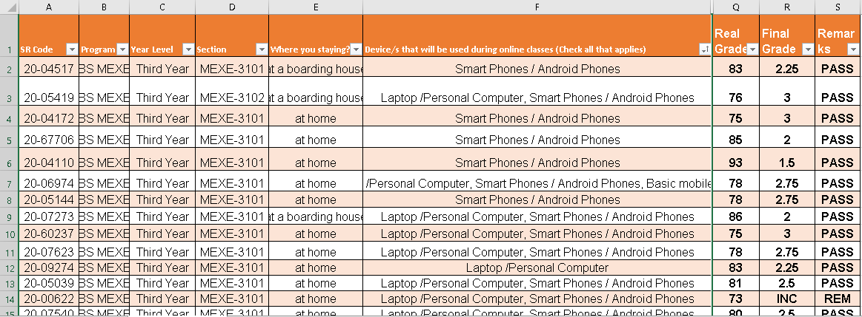
Data Source
The data came from my organization’s third year grades. These is six sections composed of their students codes or SR-Code, Program, Year Level, Sections and Final Grades and other information.

Slide 4
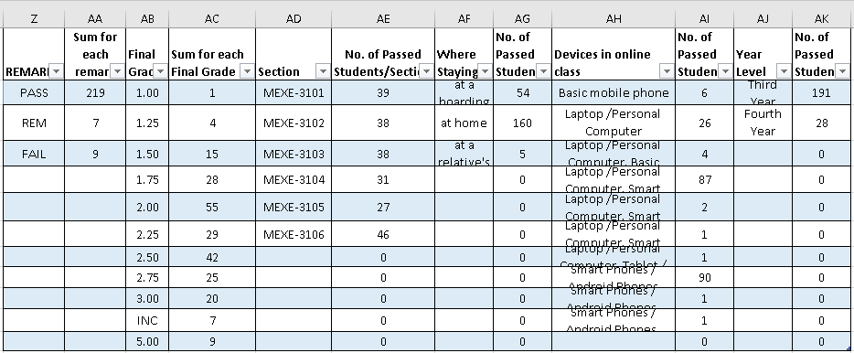
Sorted Data
I sorted the data into table that emphasize the number of passing students per field. The purpose is to make it easy to create pivot tables.
The fields were created using the countifs() function.

Slide 5
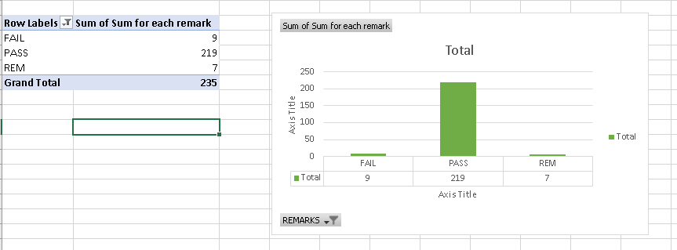
1st Pivot Table
Sum for each Remark

Slide 6
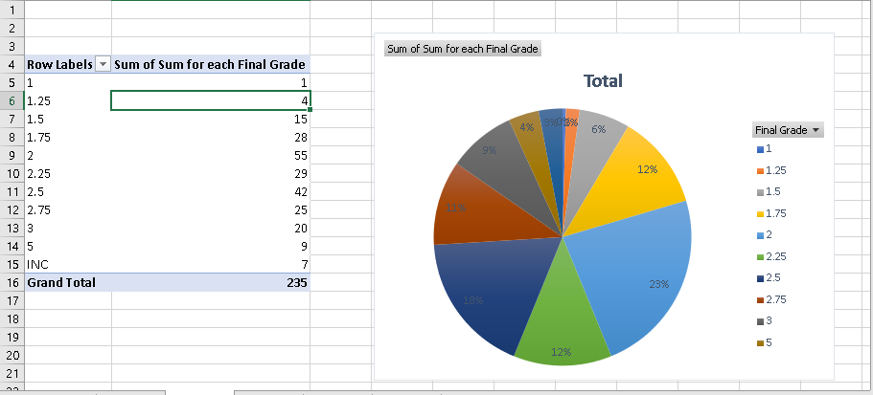
2nd Pivot Table
Sum for each Final Grade

Slide 7
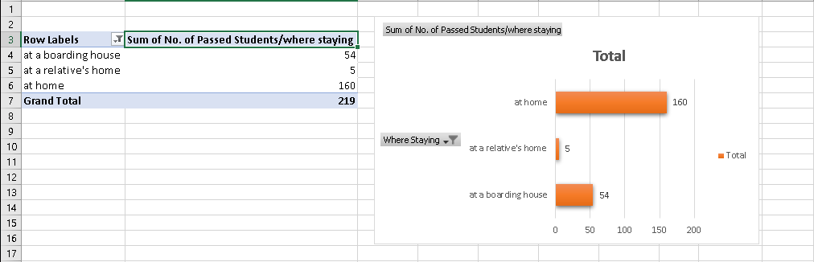
3rd Pivot Table
Sum of No. of Passed Students/where they are staying

Slide 8
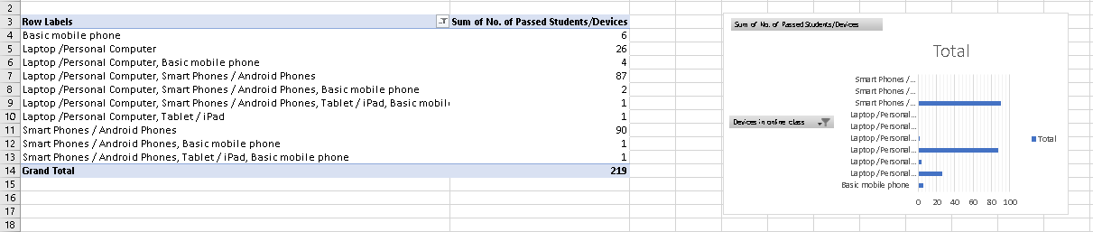
4th Pivot Table
Sum of No. of Passed Students/Devices they used

Slide 9
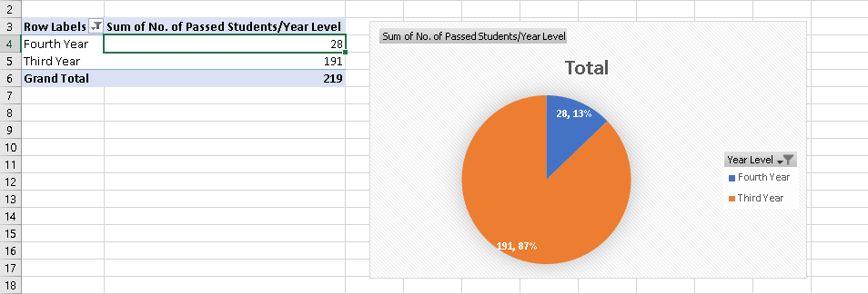
5th Pivot Table
Sum of No. of Passed Students/Year Level

Slide 10
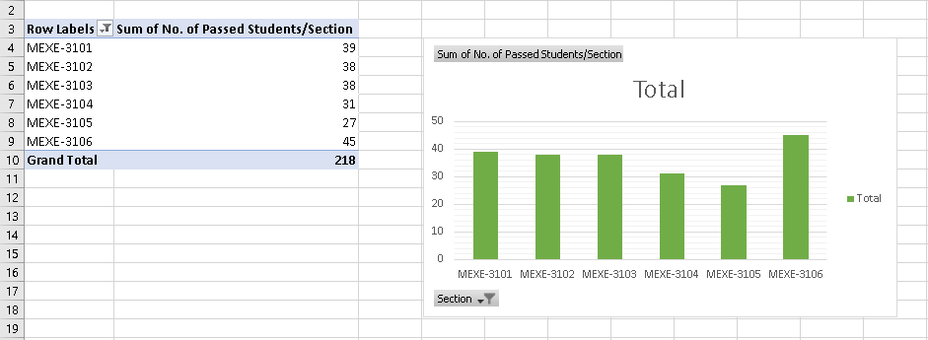
6th Pivot Table
Sum of No. of Passed Students/Section

Slide 11
Dashboard
The dashboard is linked to this slide.

Slide 12
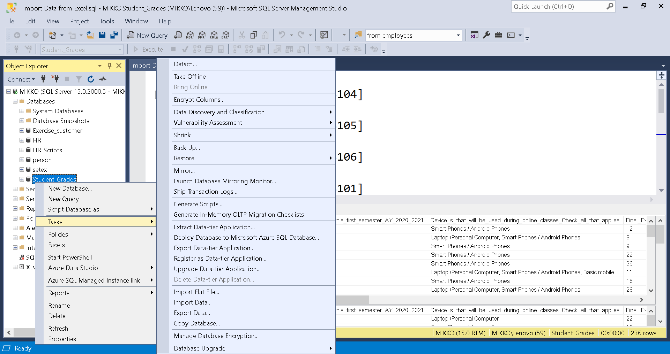
SQL
Same data used from Excel dashboard. - First create database.
- Then Data will be imported from Excel by saving it to csv (Comma Separated Values) format.
- Right click at the created Database and find ‘Tasks’

Slide 13
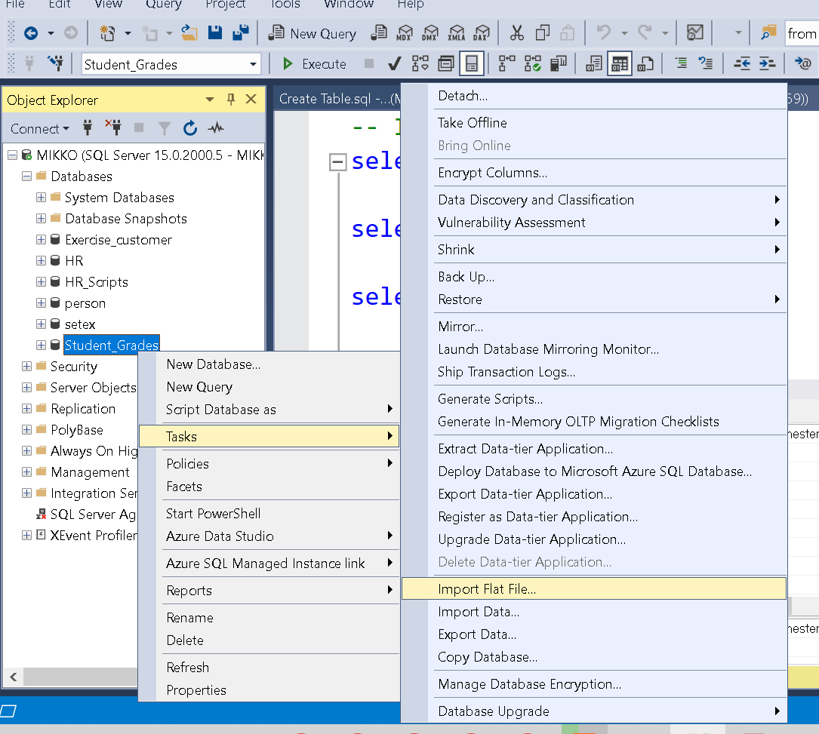
Data Source
- Go to Import Flat File

Slide 14
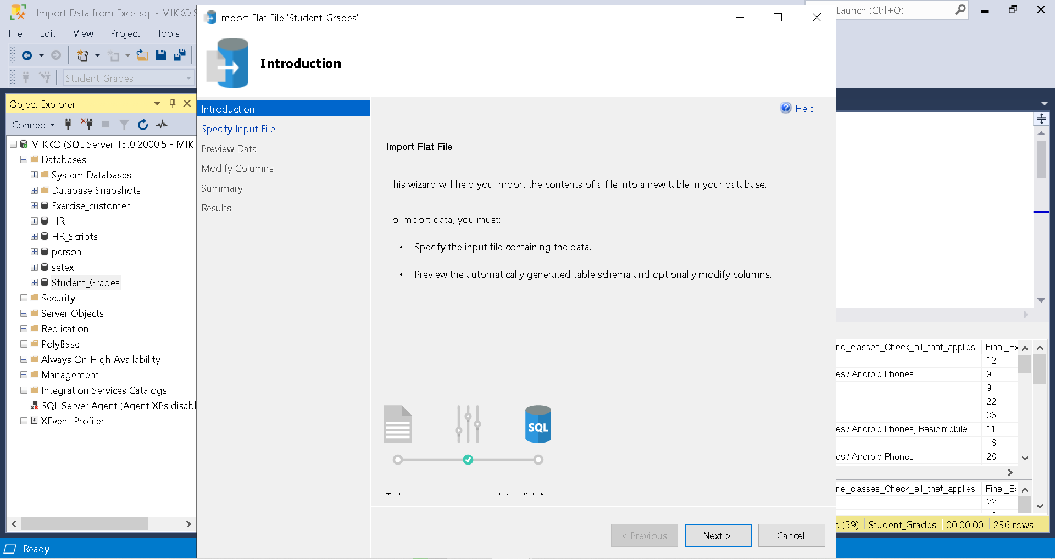
Data Source
- Click ‘Next >’.

Slide 15
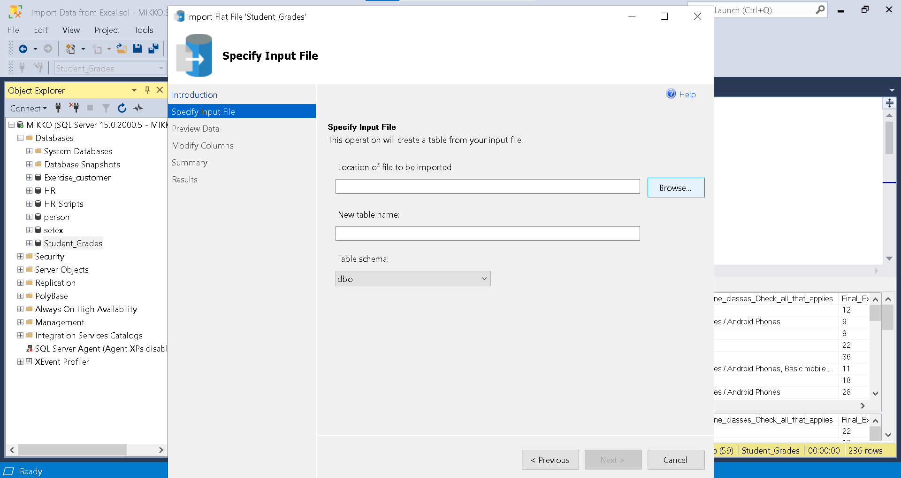
Data Source
- Browse for the csv file.

Slide 16
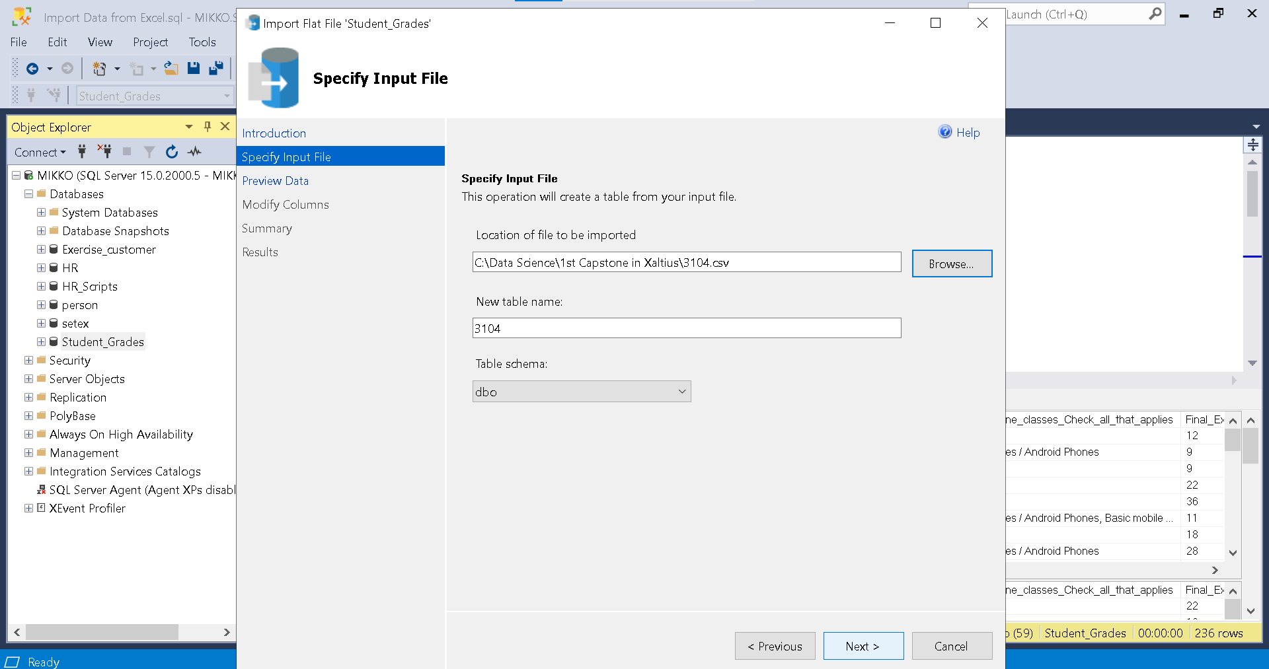
Data Source
- Then click ‘Next >’.

Slide 17
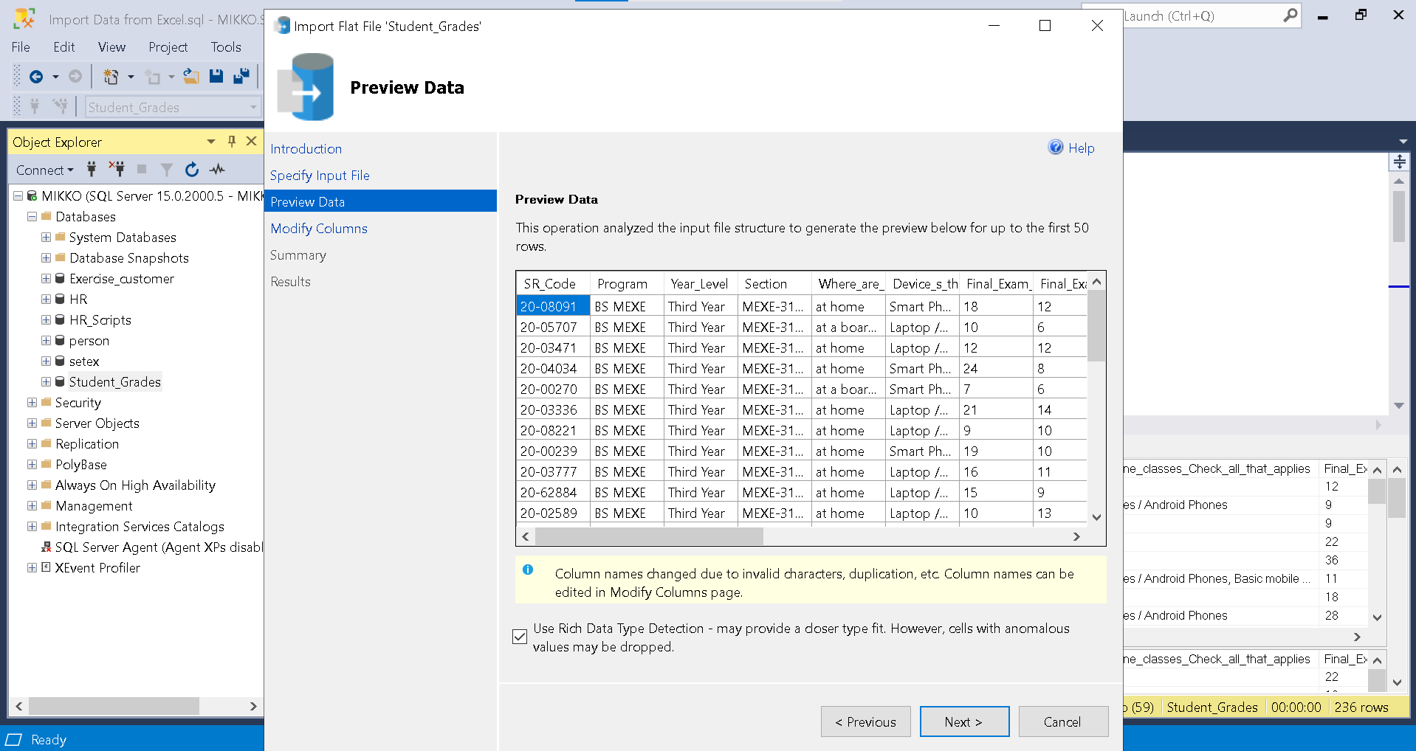
Data Source
- Preview of the Data will be shown.

Slide 18
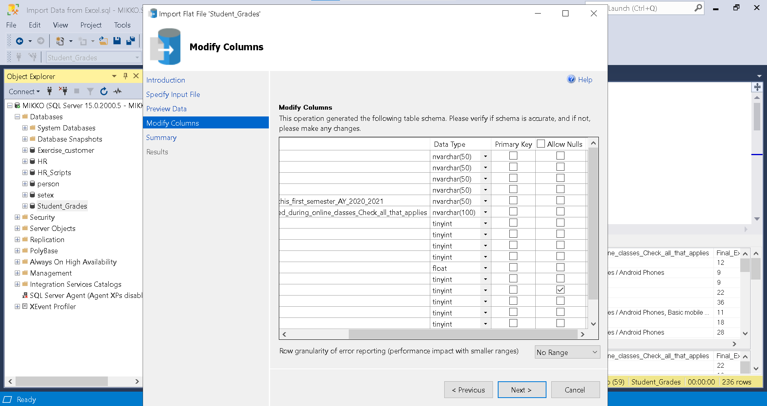
Data Source
- The data can be modify here.

Slide 19
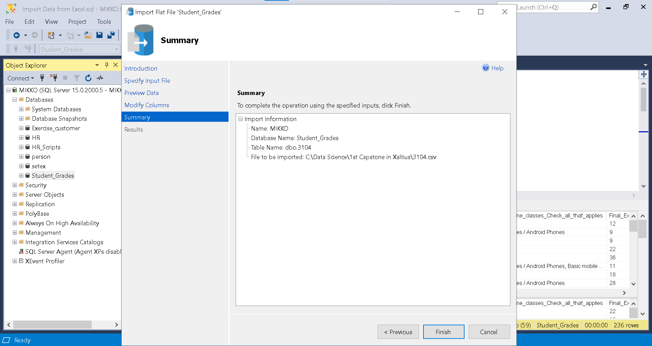
Data Source
- Lastly, if finished just click ‘Finish’.

Slide 20
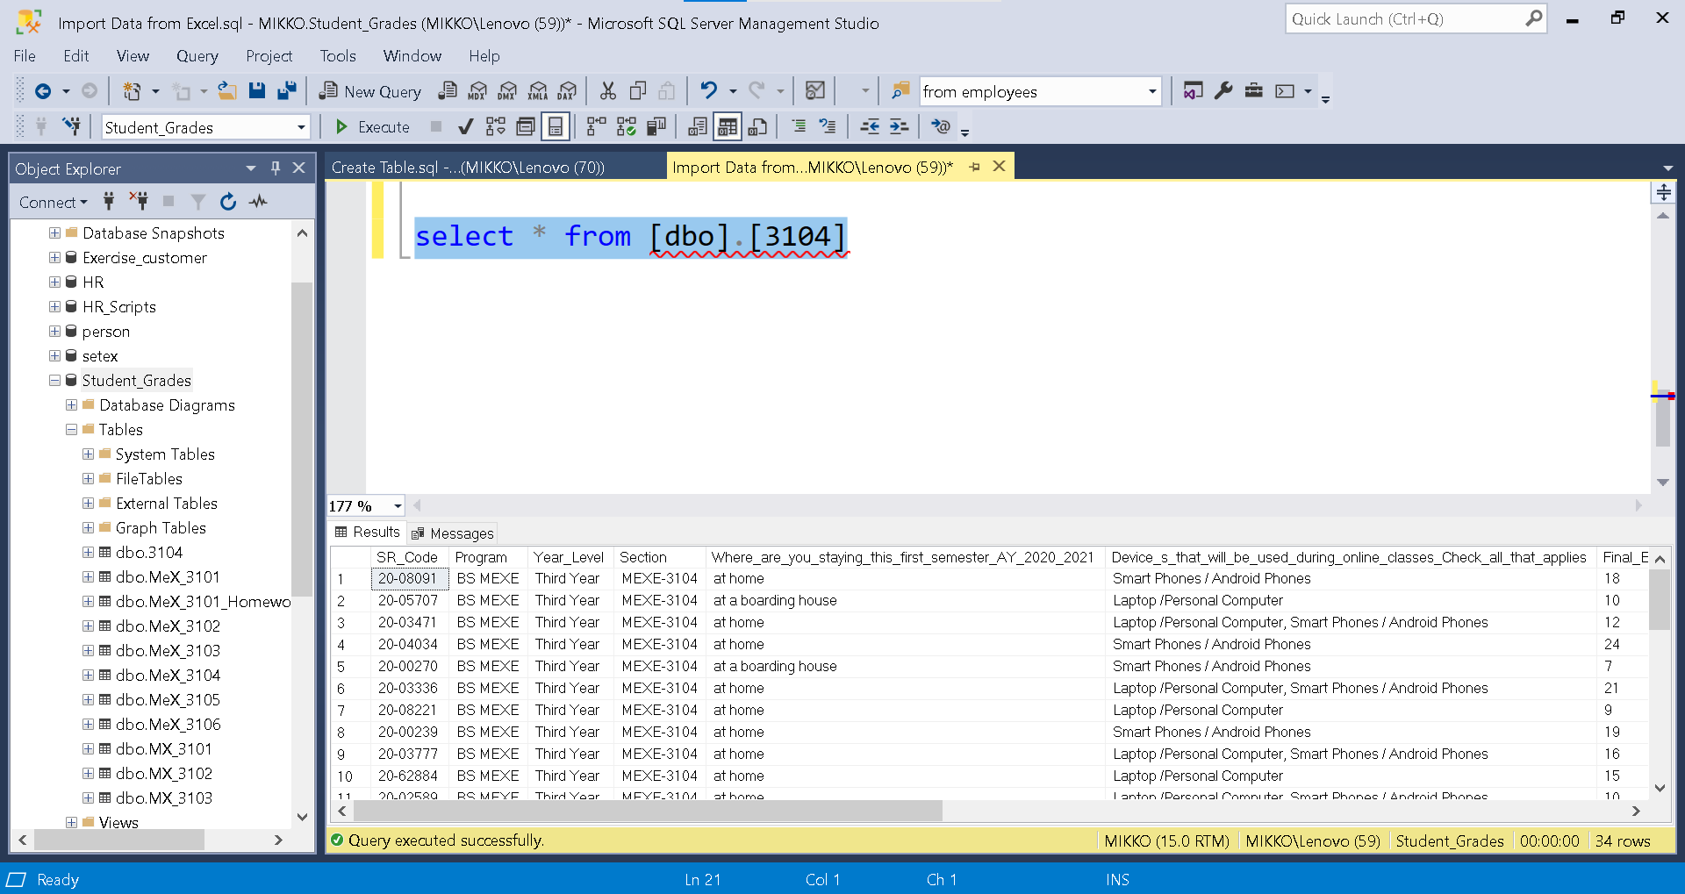
Data Source
- Check if table is imported by using SELECT and FROM queries.

Slide 21
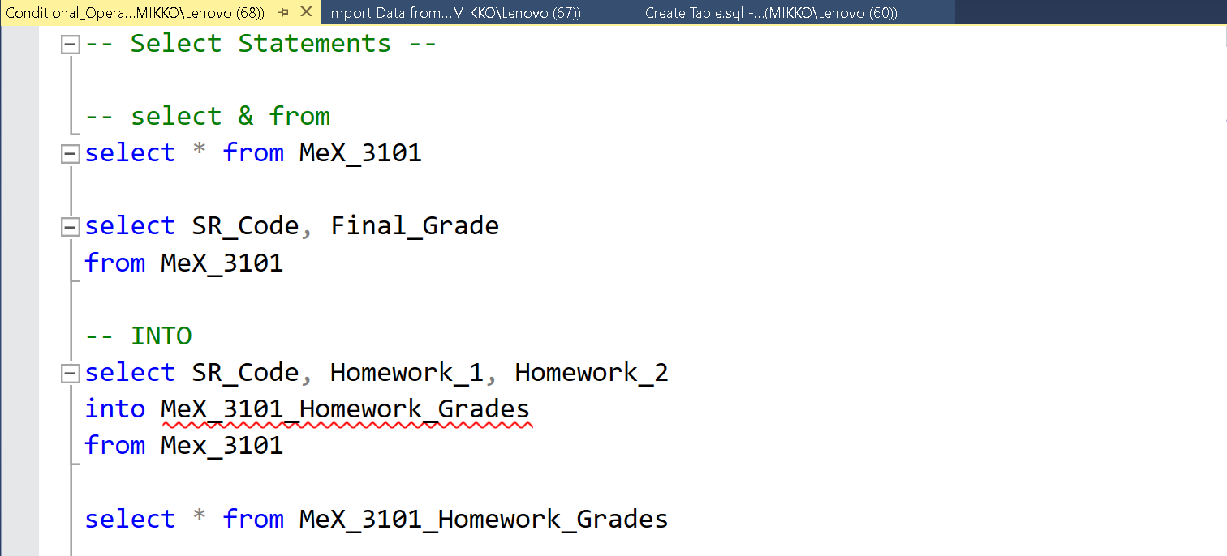
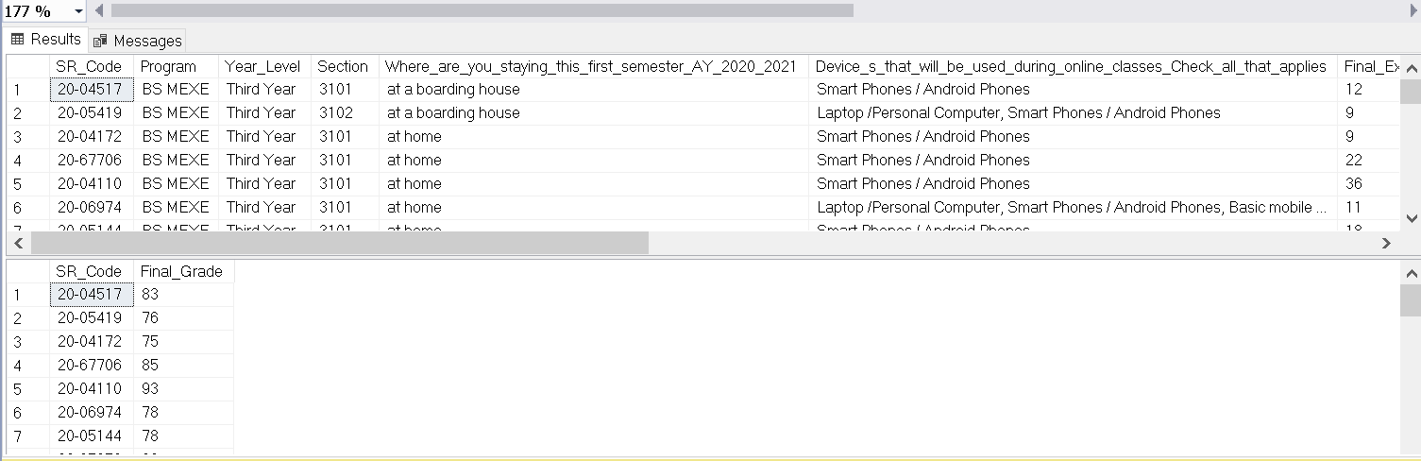
SQL Conditional Operators
The following are the codes or queries I used in my SQL report:
select & from
INTO

Slide 22
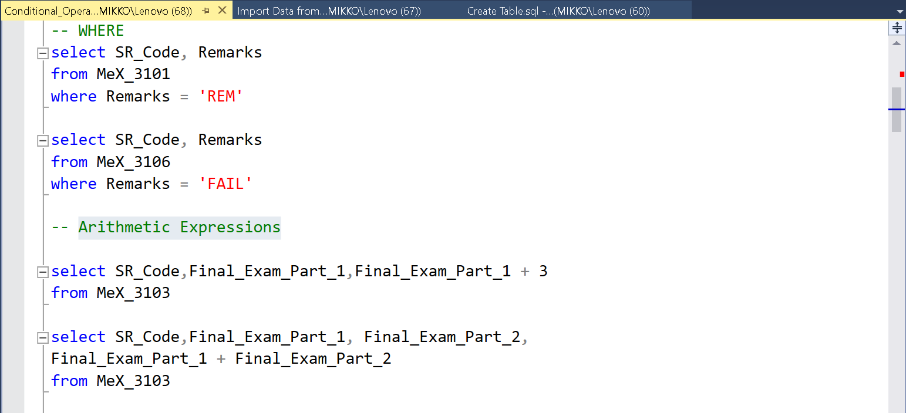
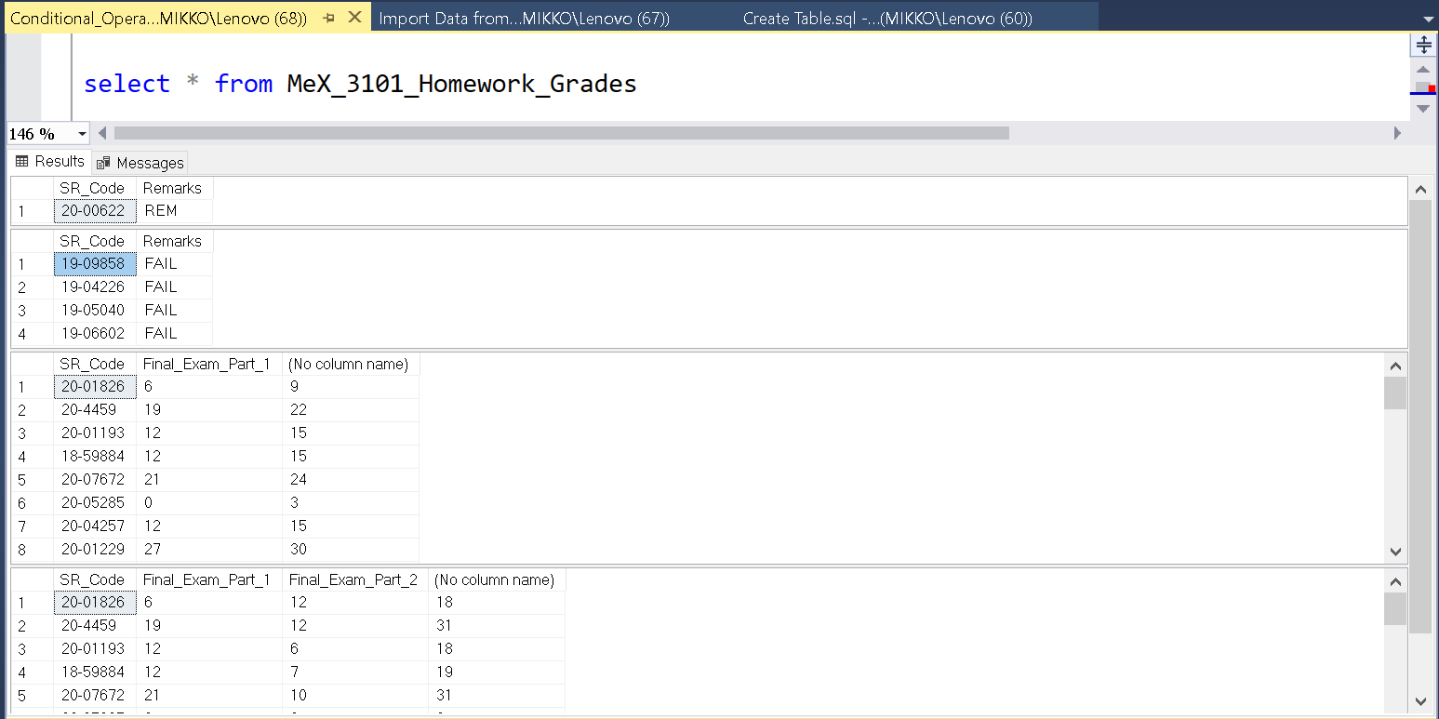
SQL Conditional Operators
4. where
5. Arithmetic Expressions

Slide 23
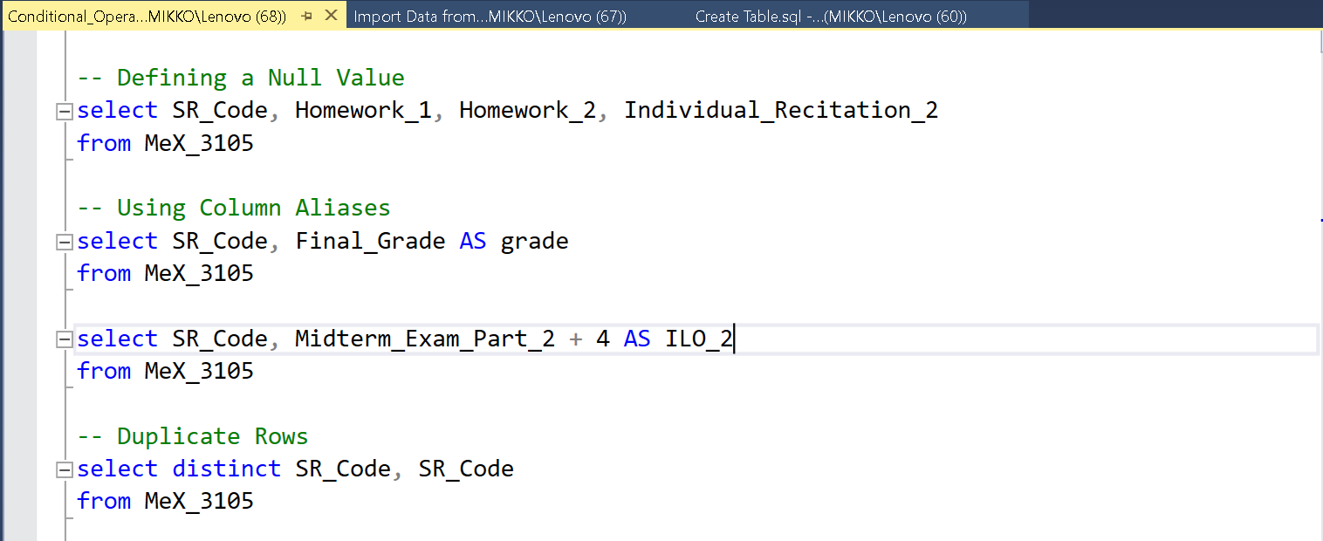
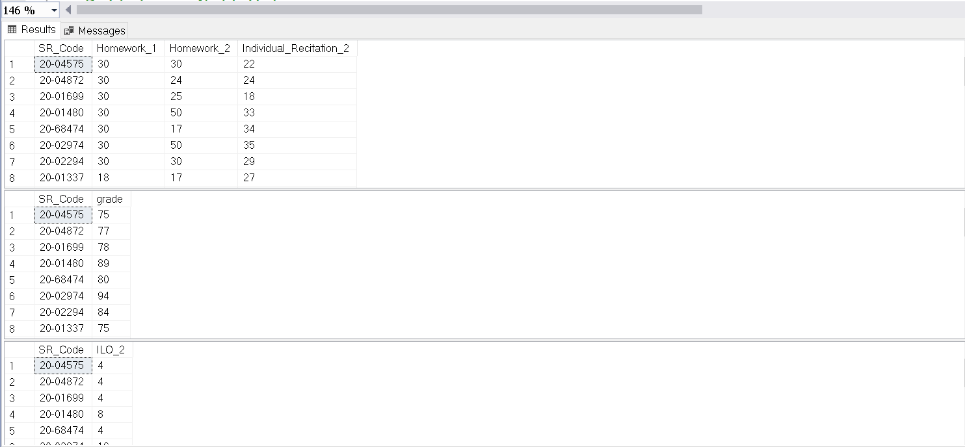
SQL Conditional Operators
Defining a Null Value
Using Column Aliases
Duplicate Rows

Slide 24
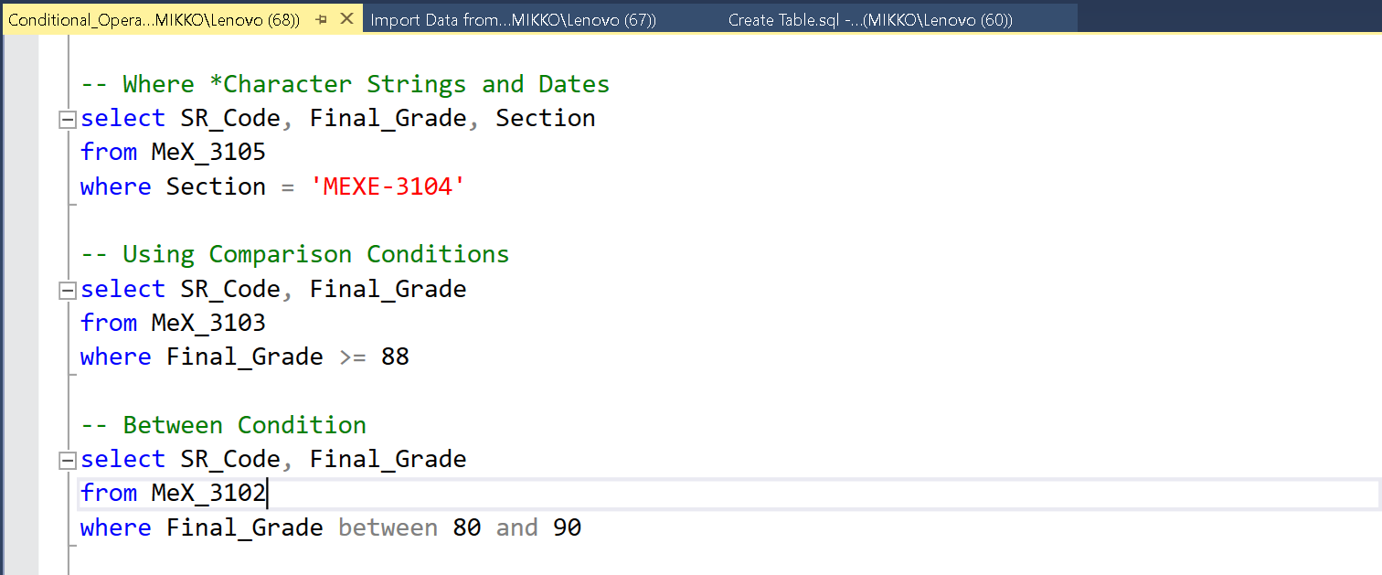
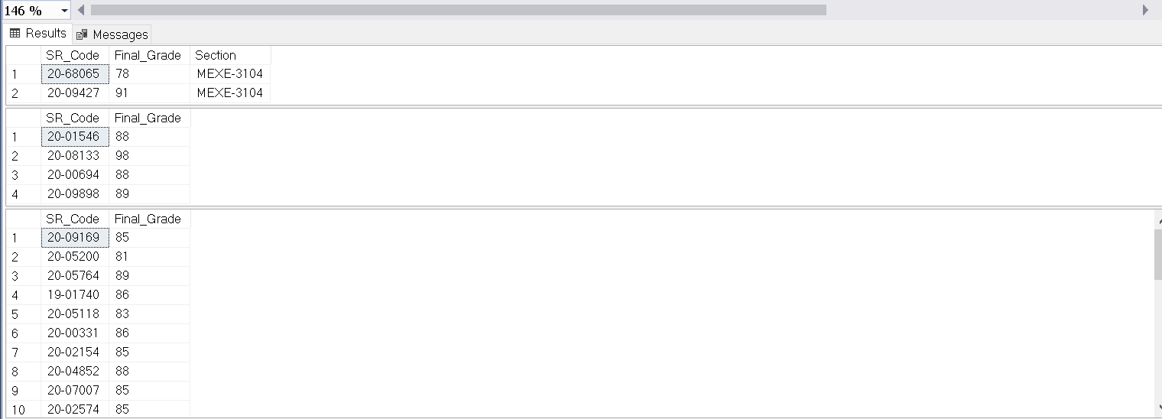
SQL Conditional Operators
Where *Character Strings and Dates
Using Comparison Conditions
Between Condition

Slide 25
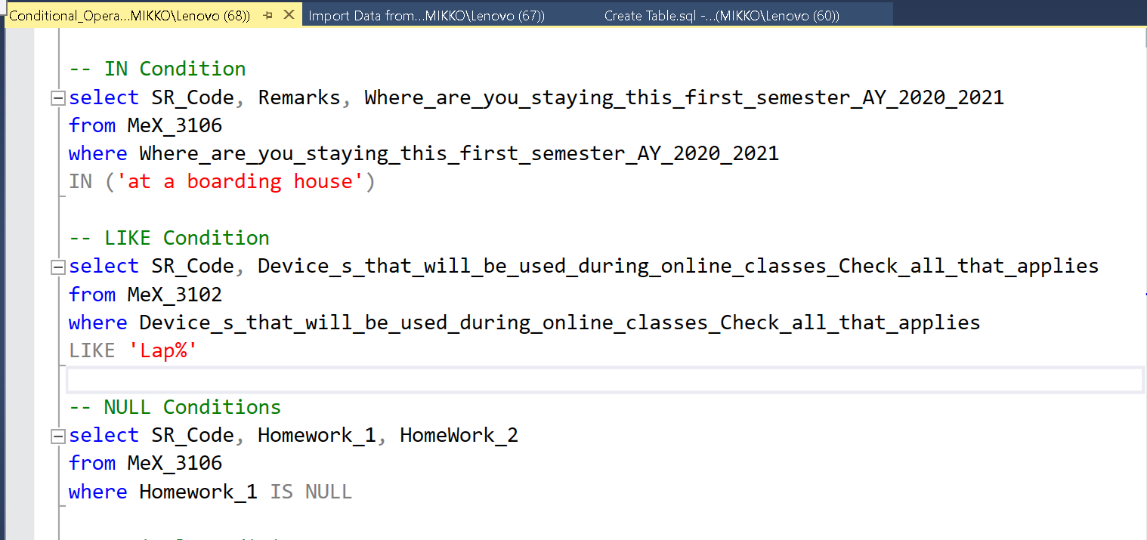
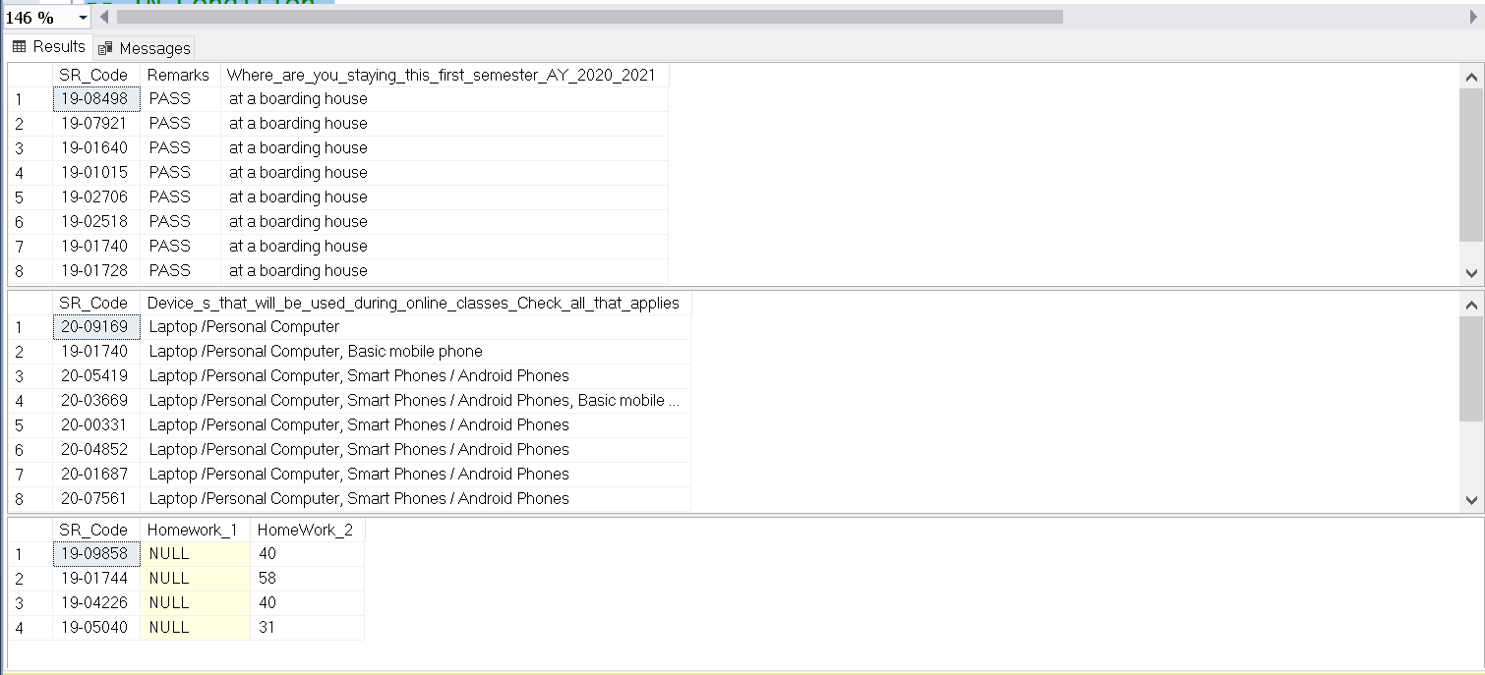
SQL Conditional Operators
IN Condition
LIKE Condition
NULL Conditions

Slide 26
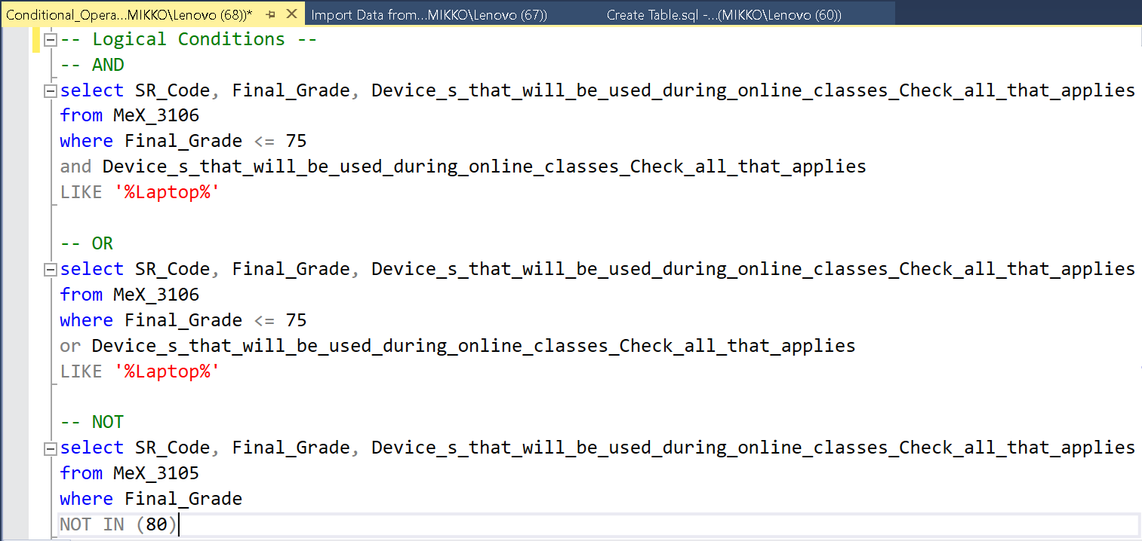
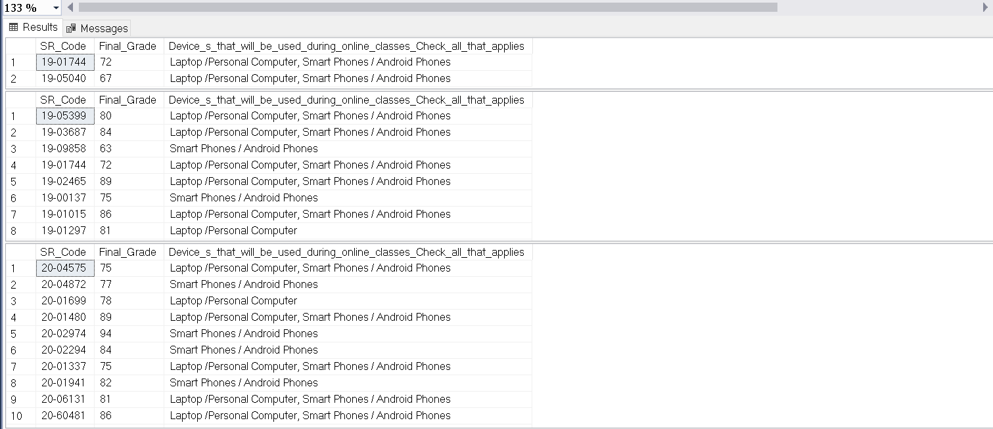
SQL Conditional Operators
AND
OR
NOT

Slide 27
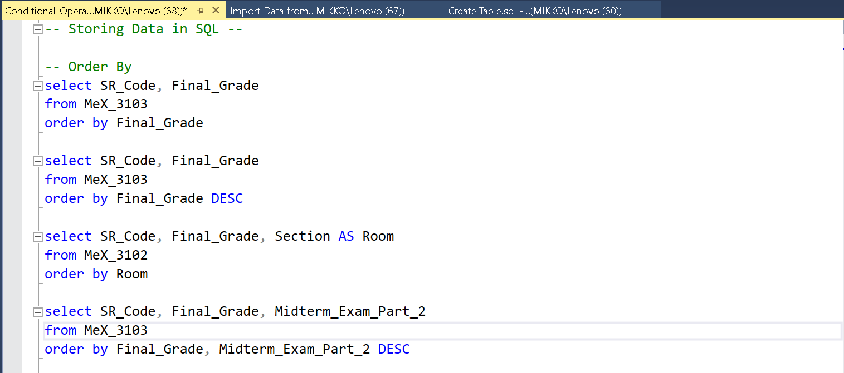
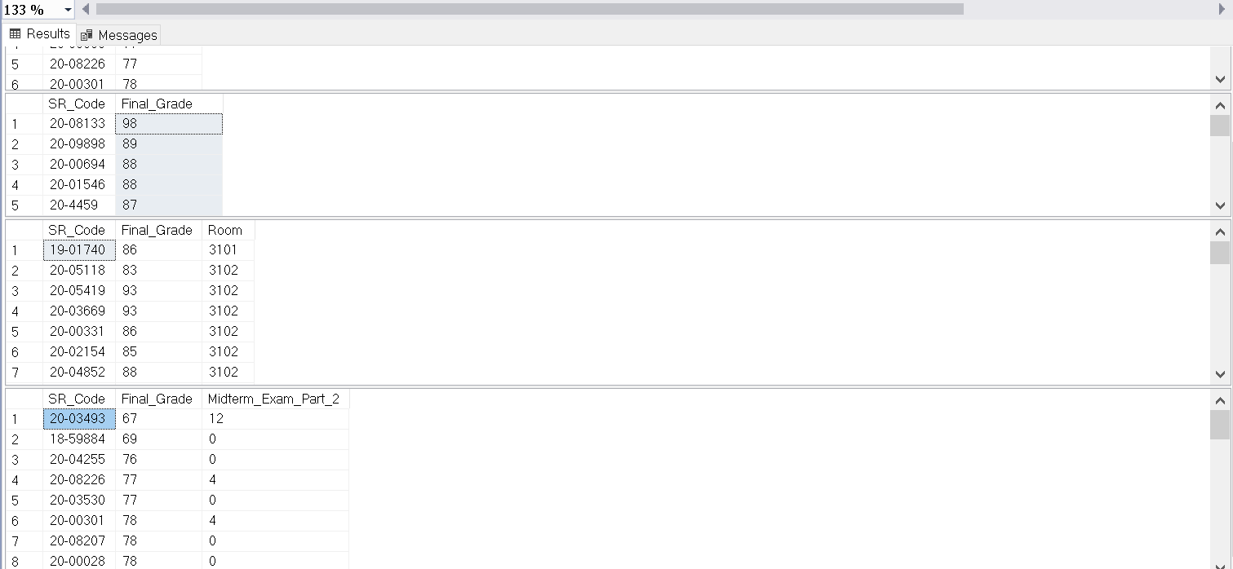
SQL Conditional Operators
Order By

Slide 28
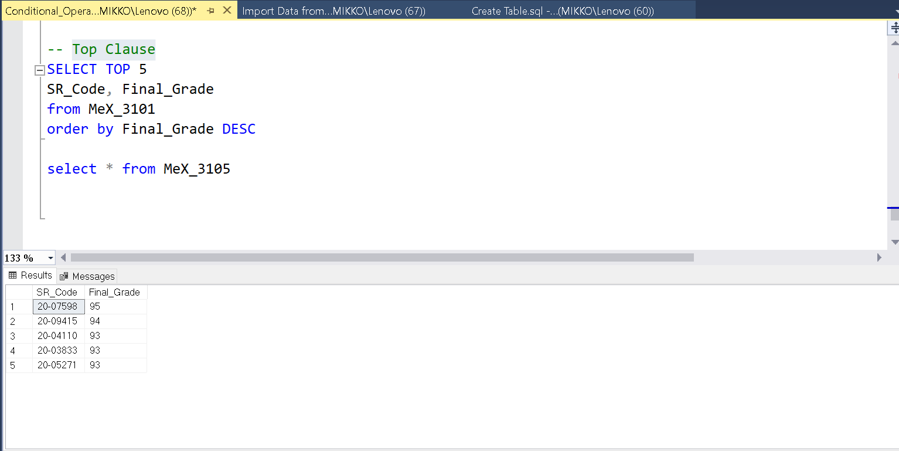
SQL Conditional Operators
Top Clause

Slide 29
THANK YOU!

